Slide 1
Exam 1 Review Ch 1-3
Kinematics, Free-fall and Projectile Motion

Slide 2
Ch 1: Vectors
Addition/Subtraction
Break into components
Find magnitude

Slide 3

Chapter 2: Kinematics
Average velocity: $v_{av}=\frac{Δx}{Δt}$
Average acceleration: $a_{av}=\frac{Δv}{Δt}$
Instantaneous velocity: $v=\frac{dx}{dt}$
Instantaneous acceleration: $a=\frac{dv}{dt}$
Notes:
Note difference between instantaneous and average
X can be any position (y, etc)

Slide 4

“Kinematics Equations”
Only work with CONSTANT ACCELERATION
$v=v_{0}+at$
$x=x_{0}+v_{0}t+\frac{1}{2}at^{2}$
$v^{2}=v_{0}^{2}+2aΔx$
$\left(x−x_{0}\right)=\frac{v_{0}+v}{2}t$
Notes:
Give example of when they will and will not work
If they don’t work, then you have to use the calculus
Note that t or a do not appear in the last two

Slide 5

Ch 2 Continued
$a=−g=−9.8\frac{m}{s^{2}}$
Derivatives
$v=\frac{dx}{dt}$, $a=\frac{d^{2}x}{dt^{2}}$
Integrals
$v=v_{0}+\int_{0}^{t}{a\left(t\right)}dt$
$x=x_{0}+\int_{0}^{t}{v\left(t\right)dt}$
Notes:
Sign of g depends on how we set up our coordinate system
Slope of x and concavity of x – draw free fall parabola

Slide 6

Ch 3 Projectile Motion
$v=v_{x}\hat{i}+v_{y}\hat{j}$
Projectile
$v(t)={v_{0}}_{x}\hat{i}+({v_{0}}_{y}−gt)\hat{j}$
$x\left(t\right)=x_{0}+v_{0x}t$, $y\left(t\right)=y_{0}+v_{0y}t−\frac{1}{2}gt^{2}$
Uniform Circular Motion
$a_{rad}=\frac{v^{2}}{R}=\frac{4π^{2}R}{T^{2}}$
Relative Velocity
$v_{\frac{A}{B}}=v_{A}−v_{B}$
Notes:
Show how you break into x and y components
How do you get position?

Slide 7
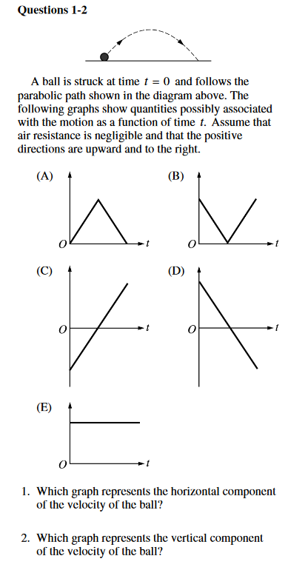

Slide 8
Suppose a hunter and a monkey are both in trees 20 m off the ground and 10 m apart. The hunter fires a blowgun at a monkey, and at the same instant, the monkey lets go of a tree branch and falls freely. Assuming, the dart leaves the gun with a velocity of 20 m/s, at what angle should the gun be aimed to hit the monkey?

Slide 9
If a planet orbiting a star at 2000 m/s undergoes an acceleration of 30 m/s², what must be the radius of its orbit? What is the period of its orbit?

Slide 10
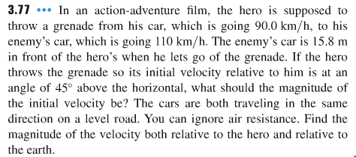
50 km/hr
5 m

Slide 11
A planet has a radius of 1000 km and turns with a period of 18 hours. What is the radial acceleration of an object on the planet’s surface? How would this change if the radius of the planet were doubled?

Slide 12
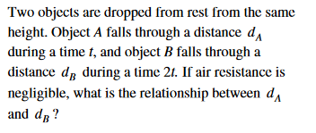

Slide 13
Fred is playing volleyball by himself by hitting the ball over the net, running to the other side, hitting it back, and so on. If he must run 10 m every time at a constant speed of 1 m/s, what is the minimum vertical speed the ball must have after Fred hits it? How high above its initial position is the ball as Fred runs past the net? What is the average vertical velocity of the ball during this time? If Fred were to run twice as fast, what would be the effect on the ball’s minimum speed after impact?
49.05 m/s, 122.625 m

Slide 14
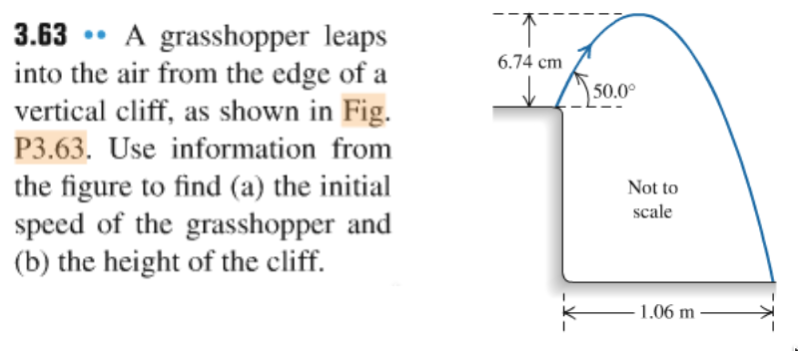
0.5 m
2 m

Slide 15
A monkey stands on a seaside cliff and lobs a coconut into the ocean with an initial velocity of 8 m/s at an angle of 20 degrees above the horizontal. How far away from the cliff is the coconut when it reaches its maximum height? What are the horizontal and vertical components of the coconut’s velocity when it passes by the monkey on its way down?
2.1 m, <7.5,-2.7>

Slide 16
Two cars are in a drag race. One car completes the race 0.8 s ahead of the other. The faster car drove with an average speed of 30 m/s while the other drove with an average speed of 28 m/s. How long (in m) was the race?
336 m

Slide 17
A monkey is standing on the ground flinging elephant droppings. If he throws the droppings with a maximum velocity of 15 m/s and an angle of 30 degrees above the horizontal, can he hit another monkey 25 m away horizontally? If he increases his angle to 45 degrees, at what speed should he throw them?
15.65 m/s

Slide 18
A spaceship is flying towards a planet’s moon with a speed of 300 m/s in the y direction relative to the moon. If the moon is moving in the x-direction relative to the planet with a velocity of 100 m/s, what is the spaceship’s velocity relative to the planet?

Slide 19
If a monkey is in a tree 45 m off the ground and throws bananas with a velocity of 12 m/s. Can she throw bananas further with an angle of 30 degrees above the horizontal or 55 degrees above the horizontal? Would the answer change if the tree were shorter or taller?

Slide 20
A car pulls away with constant acceleration for 10 seconds. It covers 100 m during the last 3 s of motion. How far did it travel during the first 7 s?
96.1 m

